Slide 1

Visualizing Incident Patterns in the Hydrogen Value Chain using Knowledge Graphs to Develop Targeted Control Measures
By
Mohammadreza Karimi Dehkordi
Dr. Lianne Lefsrud
Dr. Fereshteh Sattari

Slide 2
Outline
Introduction
Research Gap and Objectives
Knowledge Graph
Methodology
Results and Discussion
  HIAD 2.1
  Entity/Relationship Identification and Storage
  Knowledge Graph Development
  Topological Analysis
  Sensitivity Analysis
Conclusion
Notes:
I am starting with an introduction to the growth in the hydrogen economy.
The demand for hydrogen is experiencing unprecedented growth, driven by its potential to decarbonize key sectors such as transportation, industry, and energy storage.
International Energy Agency
Despite the growth in hydrogen demand and utilization around the world, hydrogen-related incident/accident statistics are growing as well.

Slide 3
Introduction
Importance of Hydrogen
  By 2050, Europe’s hydrogen demand is expected to rise significantly, reaching between 500 and 680 million metric tons (Mt), compared to 87 million metric tons (Mt) in 2020 [1]
  According to the IEA’s 2019 report “The Future of Hydrogen”, hydrogen demand is projected to grow by up to 9.2% annually through 2030 [2]
Hydrogen value chain accident/incident statistics
  From 1960 to 2020, there were 626 accidents, averaging approximately 10 accidents per year [2]
  Accidents in different application stages from the chemical and petrochemical industry to hydrogen transportation, storage, and commercial use [2]
Figure 1, HIAD 2.1 accident reports collected over time [3]
[1] Gil MKKS. Green Hydrogen: a key investment for the energy transition.World Bank Blogs; 2023, October 2. https://blogs.worldbank.org/ppps/green-hydrogen-key-investment-energy-transition
[2] The future of hydrogen – analysis - IEA. IEA; 2019. https://www.iea.org/reports/the-future-of-hydrogen
[3] HIAD 2.1 – “European Hydrogen Incidents and Accidents database HIAD 2.1, European Commission, Joint Research Centre, Petten, the Netherlands,” https://minerva.jrc.ec.europa.eu/en/shorturl/capri/hiadpt
Notes:
I am starting with an introduction to the growth in the hydrogen economy.
The demand for hydrogen is experiencing unprecedented growth, driven by its potential to decarbonize key sectors such as transportation, industry, and energy storage.
International Energy Agency
Despite the growth in hydrogen demand and utilization around the world, hydrogen-related incident/accident statistics are growing as well.

Slide 4
Research Gaps and Objectives
Table 1, Research gaps and objectives
Research Gaps | Objectives
Incident investigations have failed to capture detailed information in accident descriptions: Typically consider cause-and-effect relationships [4] Due to homogeneous structure, multi-dimensional relationships among various variables are not reflected [5] There is Limited literature focusing specifically on lessons learned and accidents within the hydrogen value chain [6] | Developing a Hydrogen value chain knowledge graph for accident analysis Get the full utilization of historical data by developing a multi-dimensional network including various entities and relationships Evaluating hydrogen incidents across the entire value chain
[4] N. Wang, X. Yang, J. Chen, H. Wang, J. Wu, “Hazards correlation analysis of railway accidents: A real-world case study based on the decade-long UK railway accident data,” Safety Science, 2023
[5] C. Liu, S. Yang, “Using text mining to establish knowledge graph from accident/incident reports in risk assessment,” Expert Systems With Applications, 2022
[6] Campari A, Nakhal Akel AJ, Ustolin F, Alvaro A, Ledda A, Agnello P, Moretto P, Patriarca R, Paltrinieri N. Lessons learned from HIAD 2.0: inspection and maintenance to avoid hydrogen-induced material failures. Comput Chem Eng 2023

Slide 5
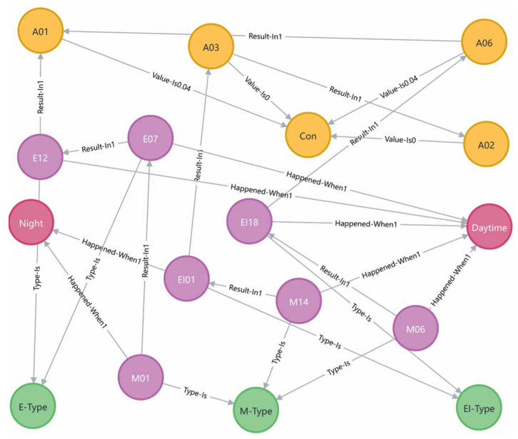
Knowledge Graph
What is a Knowledge Graph? [7]
  Entities and relationships
  Various link patterns
How can we benefit from KGs?
  Incident investigation (causality analysis) considering the hazard types and relationships
  Analysis based on the involved equipment/ stage of use
  Given weight to the consequences
Figure 2, An Example of a Knowledge Graph
[7] Zhao et al., Construction of petrochemical knowledge graph based on deep learning, Journal of Loss Prevention in the Process Industries 2022
Notes:
What is KG?
A knowledge graph is a method of representing knowledge using a graph structure. Entities within this framework can encompass substances existing in the objective world or abstract concepts, while relationships denote the relationships between these entities
KG include various combined link patterns, such as many-to-many and many-to-one relationships, as well as many-to-one and multi-step combinations. For example, in a cause-effect relationship, many-to-many means that one cause can lead to multiple effects, and one effect can result from multiple causes. Multi-step refers to a causal path that involves two or more sequential cause-effect links.
- Benefits of KG include hazard causations analysis considering their type, distribution across the value chain stages, understanding the involved equipment, and many topological analyses which we will discuss in the next slides.

Slide 6
Methodology
HIAD 2.1
Entity and Relationship Identification
Identify various entities from the incident database
Network Topology Analysis
Knowledge Graph Structural Modeling matrices
Identify the relationships among the identified entities
Causal closeness of hazards
Distribution proportion of hazards
Accessibility between hazard types
Direct & indirect risk of hazards
Equipment involved at each stage
Causality matrix (W)
Type matrix (UW)
Severity matrix (W)
Stage matrix (UW)
Knowledge Storage and Representation
Store the knowledge in the form of triples
< Entity head, Relation, Entity tail >
Develop the Knowledge Graph from knowledge triples
Figure 3, Framework of the proposed methodology
Notes:
1- Entities include Hazards, Hazard types, accidents, severity of the accidents, stage of the hydrogen value chain, and involved equipment
2- the relationship among these entities is represented using special keywords such as ‘Cause’, ‘ResultIn’, ‘EscalateInto’, ‘TypeIs’, ‘HappenedIn’, ‘ValueIs’, and ‘Involved’.
3- Knowledge graph structural modeling using different types of matrices.

Slide 7
HIAD 2.1 Data set
Hydrogen Incident and Accident Database (HIAD 2.1) maintained by the Joint Research Centre (JRC) of the European Commission [3]
After excluding the accident reports with incomplete descriptions, duplicates, or missing information, a total of 169 accidents/incidents were selected
Figure 4, Statistics of accidents across stages of the hydrogen value chain
[3] HIAD 2.1 – “European Hydrogen Incidents and Accidents database HIAD 2.1, European Commission, Joint Research Centre, Petten, the Netherlands,” https://minerva.jrc.ec.europa.eu/en/shorturl/capri/hiadpt

Slide 8
Entities and Relationships
Table 3, Severity classes and their respective weights
Table 4, Entities – Relationship Mapping
Table 2, Identified hazard entities and hazard types
Harm to people | Asset Damage | Weighting
Not reported | Not reported | -
No injury | No damage (No disruption) | 0
Minor injuries (First aid/medical treatment) | Minor damage (Cost less than 100,000$) (Brief disruption) | 0.04
Major injury (Affecting work performance) | Major damage (Costs up to 500,000$) (Partial shutdown) | 0.2
Single fatality | Severe damage (Costs up to 10,000,000$) (Partial operation loss) | 1
Multiple fatalities | Extensive damage (Costs over 10,000,000$) (Total loss of operation) | 5
Entities | Relationship | Knowledge Triple
Hazard entity – Hazard entity | Cause | <H-01, Cause, H-02>
Hazard entity – Accident entity | Result_In | <H-01, Result_In, A-01>
Accident entity – Accident entity | Escalate_Into | <A-01, Escalate_Into, A-02>
Hazard entity – Hazard Type | Type_Is | <H-01, Type_Is, M-Type>
Hazard entity – Stage of the value chain | Happened_In | <H-01, Happened_In, P>
Accident entity – Severity of consequence | Value_Is | <A-01, Value_Is 0.04, SC >
Stage of the value chain – Main equipment involved | Involved | <P, Involved, Eq-01>
Hazard Type | Hazard ID | Hazard Description
H-Type | H-01 … H-13 | Lack of operator knowledge … Erroneous actions during maintenance/inspection
O-type | O-01 … O-20 | Operational failure … Hydrogen embrittlement
M-type | M-01 … M-18 | Inadequate/lack of proper operational procedure … Inappropriate operational planning/decision-making
E-type | E-01 …. E-07 | High ambient temperature … Narrow space

Slide 9
Entity/Relationship Identification and Storage
Table 5, Selected hydrogen value chain accidents from the database
Event |  |  |  | Facility |  | Severity
ID | Description | Consequence | Cause | Supply Chain | Components Involved | # of injuries | # of fatalities | Environmental/ Asset damage (cost) | Disruption
970 | “The hydrogen buffer tanks that exploded were part of an experimental facility experimenting generation of renewable hydrogen from a water electrolyser coupled to solar panels. The three hydrogen tanks […]” | Explosion | “According to the preliminary results of the legal investigation, the hydrogen and buffer tanks exploded due to a static spark in the hydrogen buffer tank, with oxygen concentration exceeding 6%, which is explosion threshold. The presence of oxygen in the […]” | hydrogen production | water electrolyser, hydrogen storage tank | 6 | 2 | - | -
Table 6, Identified knowledge entities and knowledge triples from the selected accidents
ID | Knowledge entities | Knowledge triples
970 | M-02: Improper design/material selection; O-01: Operational failure; H-02: Poor decision-making by the operators; A-02: Explosion accident; SC; M-Type; O-Type; H-Type; P; Eq-07 | <M-02, Cause, O-01>, <O-01, Result_In, A-02>, <H-02, Result_In, A-02>, <A-02, Value_Is 5, SC>, <M-02, Type_Is, M-Type>, <O-01, Type_Is, O-Type>, <H-02, Type_Is, H-Type>, <M-02, Happened_In, P>, <O-01, Happened_In, P>, <H-02, Happened_In, P>, <P, Involved, Eq-07>

Slide 10
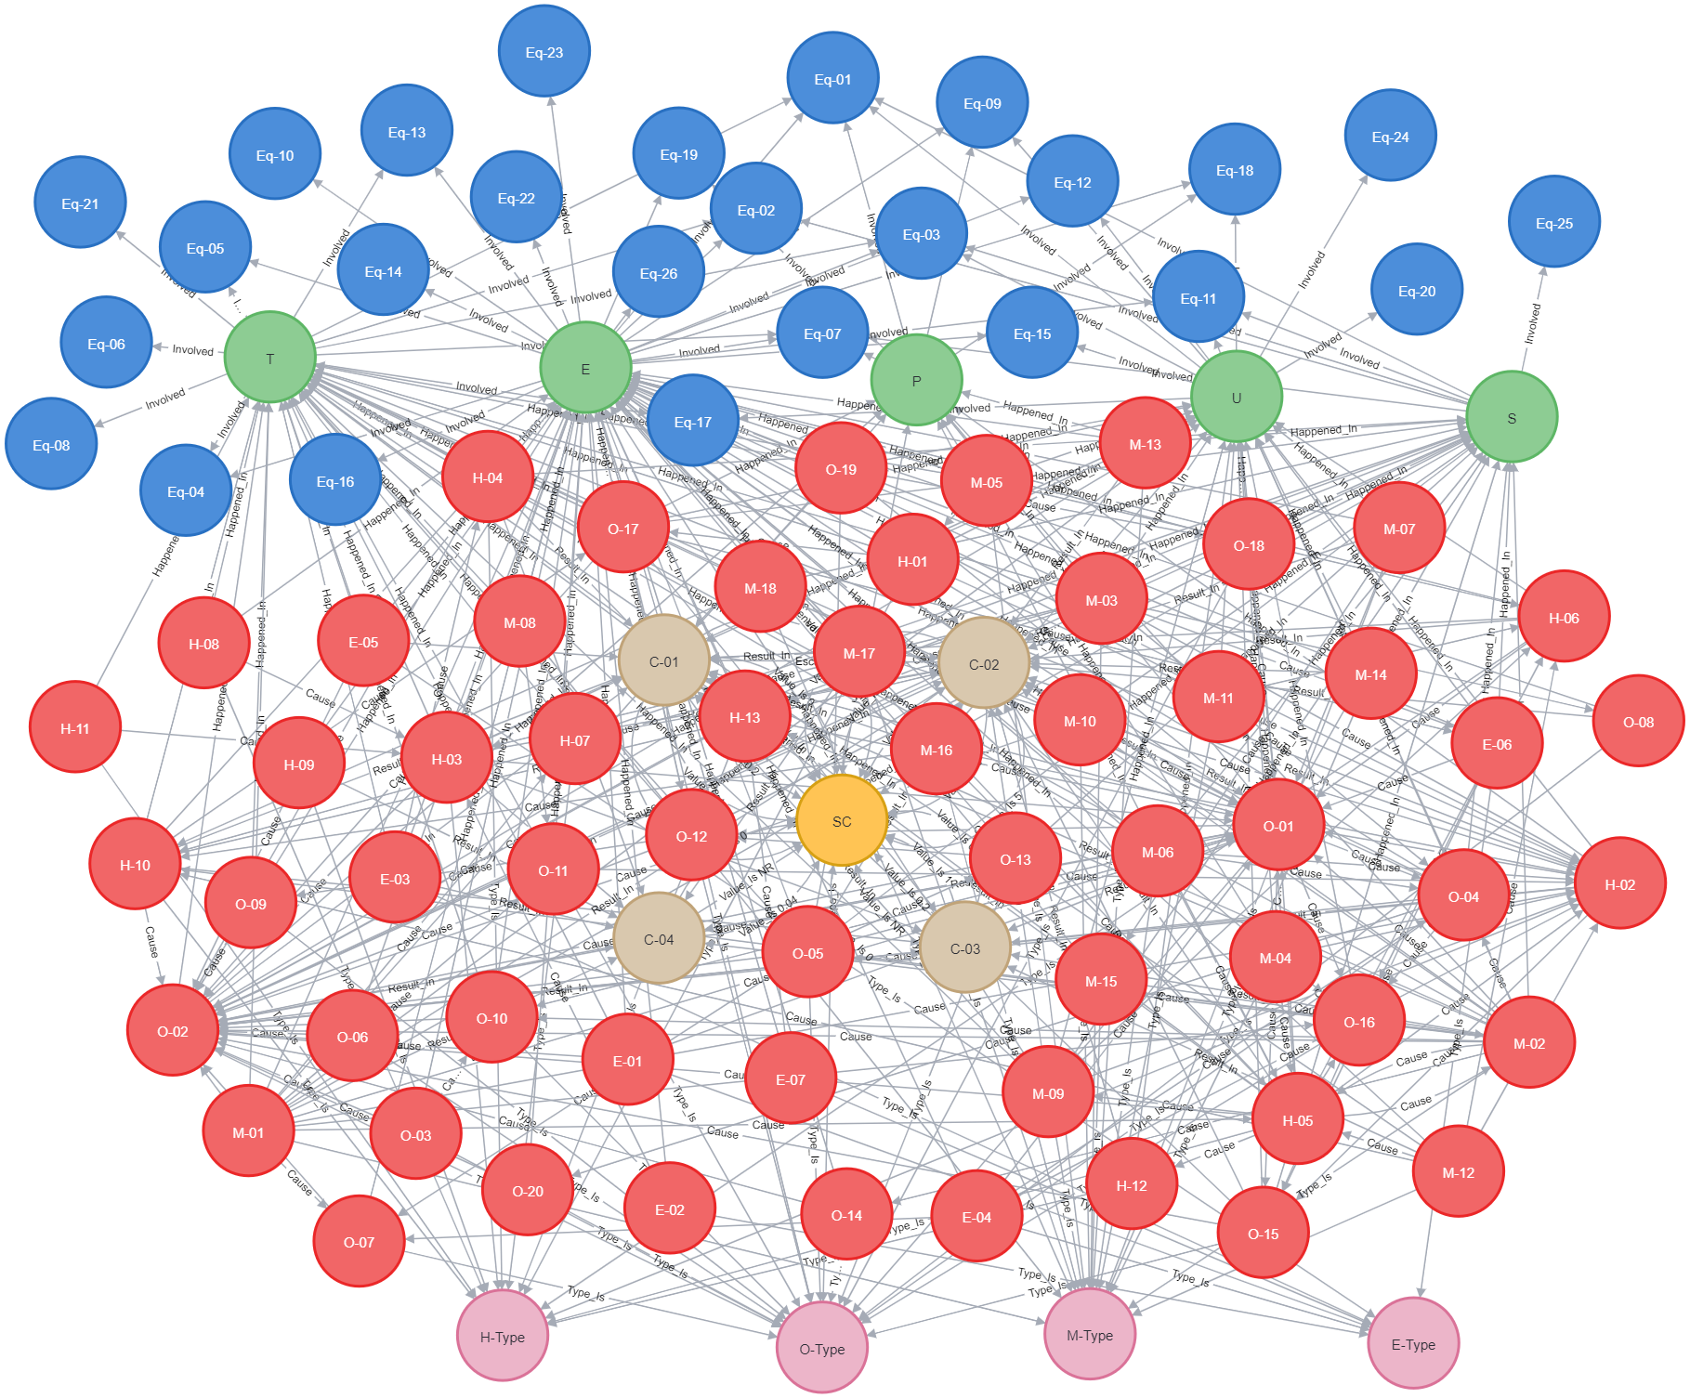
Knowledge Representation
Equipment Entity
Stage Entity
Severity Class Entity
Accident Entity
Hazard Entity
Type of hazard Entity
Figure 5, Hydrogen Value Chain knowledge Graph

Slide 11
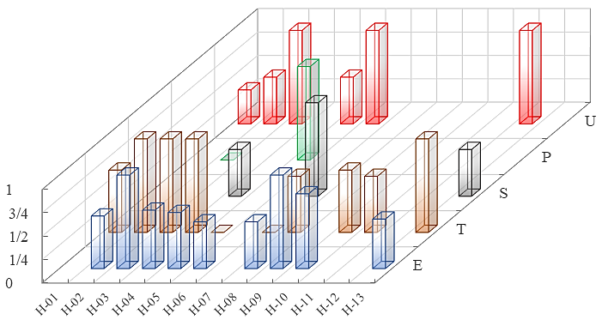
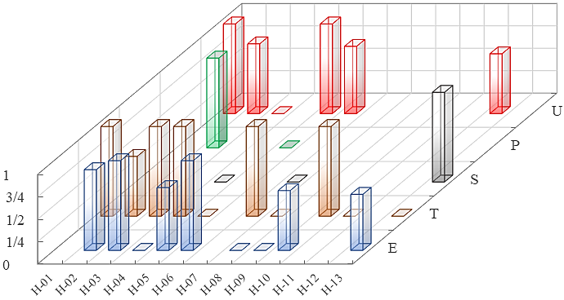
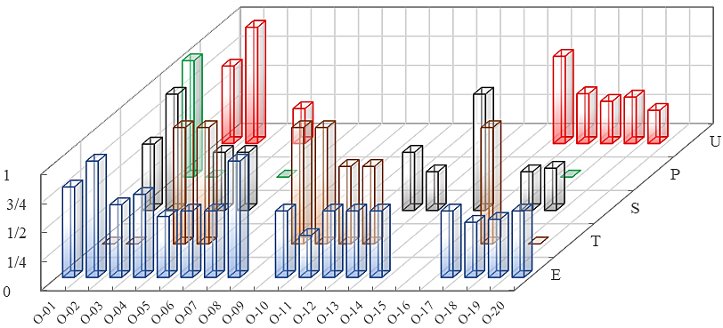
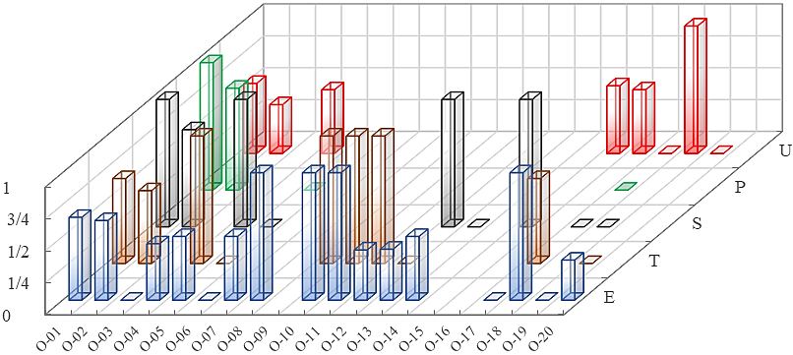
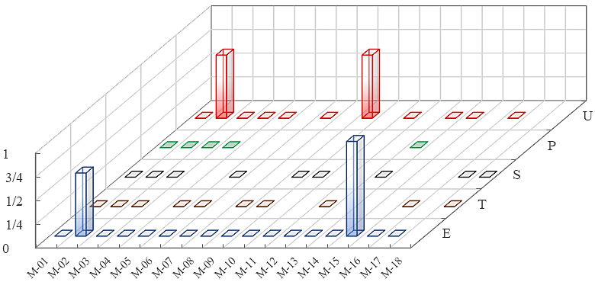
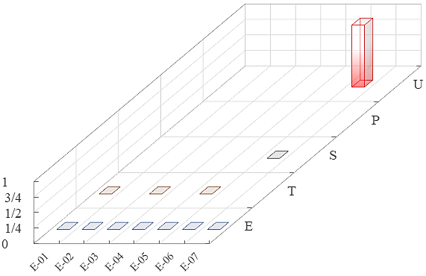
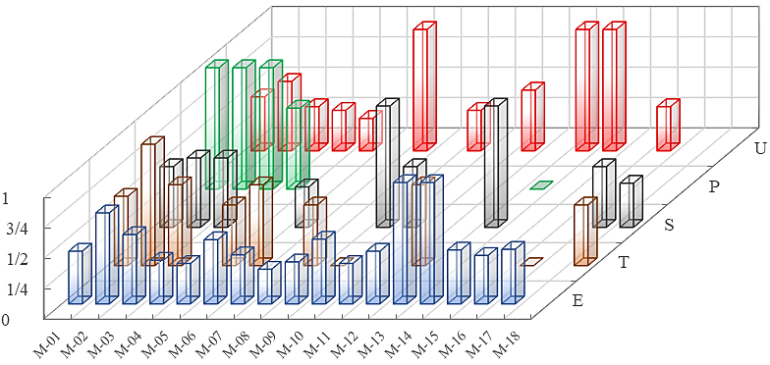
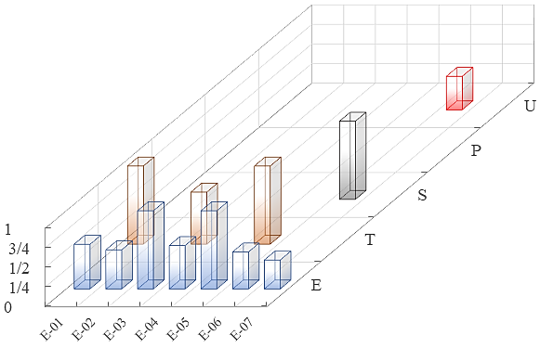
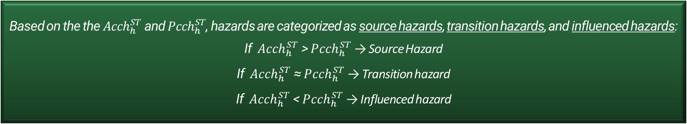
Active/Passive causal closeness of hazards
It quantifies the influence of all hazards that directly or indirectly cause a given hazard within a specific stage.
It quantifies the influence of a hazard to all hazards it directly or indirectly causes within a specific stage.
Based on the the ${Acch}_{h}^{ST}$ and ${Pcch}_{h}^{ST}$, hazards are categorized as source hazards, transition hazards, and influenced hazards:
If ${Acch}_{h}^{ST}$ > ${Pcch}_{h}^{ST}$ → Source Hazard
If ${Acch}_{h}^{ST}$ ≈ ${Pcch}_{h}^{ST}$ → Transition hazard
If ${Acch}_{h}^{ST}$ < ${Pcch}_{h}^{ST}$ → Influenced hazard
Some Results
- The role of the management and environment hazards as source hazards across the value chain stages
- The role of the Human and object hazards as transition hazards
Figure 6, Active causal closeness of hazards within hydrogen value chain stages
Figure 7, Passive causal closeness of hazards within hydrogen value chain stages

Slide 12
Active distribution proportion of hazard types
The proportion of P-Type hazards directly caused by a specific hazard h within the value chain stages
Some results
- Most H-type hazards cause O-type hazards
- M-type hazards mainly cause H-type and O-type hazards across the value chain stages
(showing the importance of management-related hazards in influencing other type of hazards)
Figure 8, Active distribution proportion of hazard types within hydrogen value chain stages – E stage

Slide 13
Passive distribution proportion of hazard types
The proportion of P-Type hazards that can directly contribute to causing a specific hazard h within the value chain stages
Some results
- H-type hazards are primarily caused by management hazards
- O-type hazards are mainly caused by M-type and O-type hazards
- M-type and E-type hazards are rarely caused by other hazard types
Figure 8, Passive distribution proportion of hazard types within hydrogen value chain stages – E stage

Slide 14
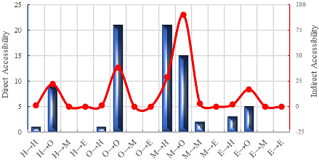
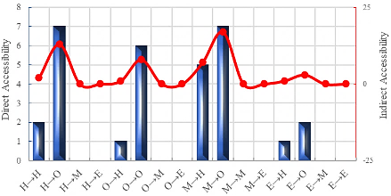
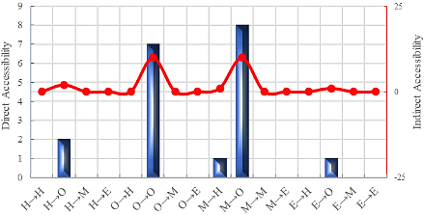
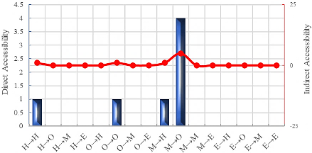
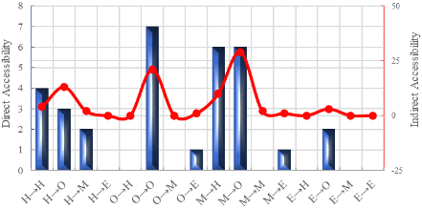

Direct/Indirect accessibility between hazard types
Number of direct edges connecting U-Type hazards and V-Type hazards, which constitutes the local connectivity of two hazard types within a specific stage
Some results
- M-type hazards show the highest accessibility, particularly in accessibilities such as M → H and M → O, highlighting their dominant role in influencing other hazards
- In the indirect accessibility similar patterns can be seen, however the values in the indirect accessibility are significantly higher than those in the direct accessibility
Number of indirect edges connecting U-Type hazards and V-Type hazards, which constitutes the global connectivity of two hazard types within a specific stage
End-user
Transportation
Storage
Production
Unintended production
Figure 10, Direct/Indirect accessibility between hazard types within hydrogen value chain stages

Slide 15
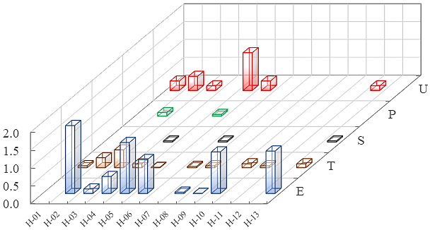
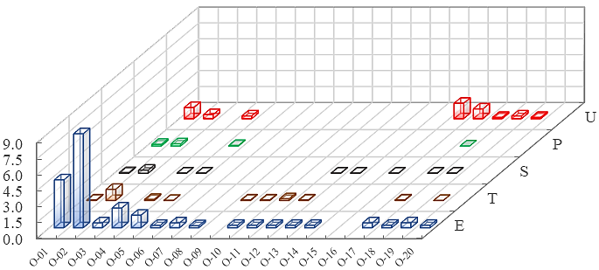
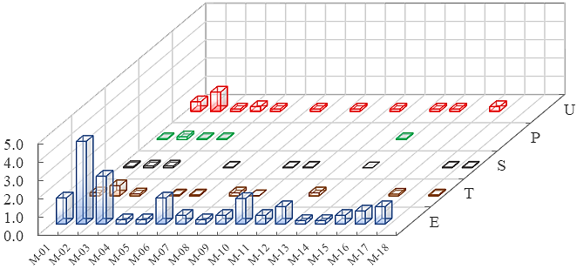
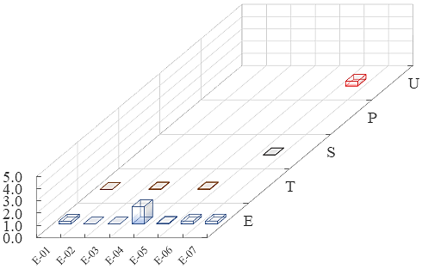
Direct Risk
Direct risk of hazard represents the risk posed by each hazard and is intended to measure the potential for injury to people, asset loss, and operational disruption.
Figure 12, Direct risk of hazards within hydrogen value chain stages

Slide 16
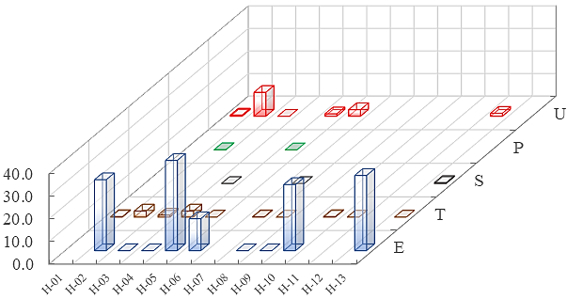
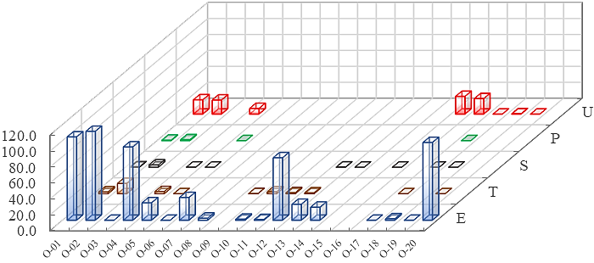
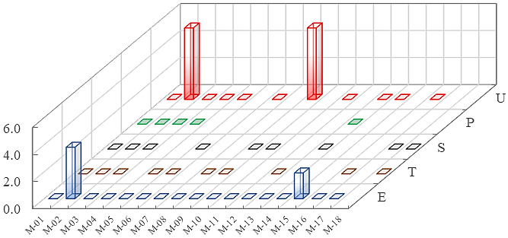
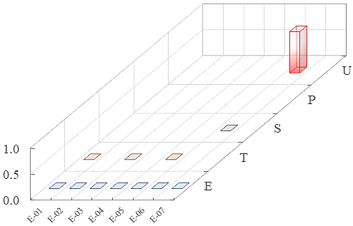
Indirect Risk
Indirect risk of hazard refers to the risk posed by a hazard that can result in other hazards and be the resulted of other hazards, highlighting its pivotal role in the propagation of hazards.
Some results
- O-type hazards present the highest direct and indirect risks across the value chain stages.
- For all hazards, indirect risks are generally higher than direct risks.
- M-type and E-type hazards show almost no indirect risk.
Figure 13, Indirect risk of hazards within hydrogen value chain stages

Slide 17
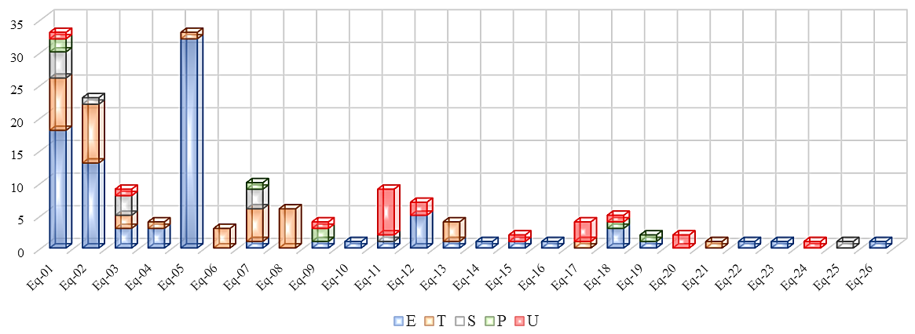
Equipment involvement within the stages
Table 7, Main equipment involved in the accidents
Id | Description | Id | Description
Eq-01 | Auxiliary Equipment | Eq-14 | Pump
Eq-02 | Piping/valves | Eq-15 | Furnace
Eq-03 | Safety and Control Equipment | Eq-16 | Heat exchanger
Eq-04 | Dispensing Equipment | Eq-17 | Power Supply System
Eq-05 | Hydrogen Fuel Cell Vehicles | Eq-18 | Flare/vent stack
Eq-06 | Hydrogen Transport Tankers | Eq-19 | Chamber
Eq-07 | Hydrogen storage vessels | Eq-20 | Sprinkler system
Eq-08 | Hydrogen cylinder of tube trailer | Eq-21 | Compressed air network
Eq-09 | Electrolyser | Eq-22 | Hydrogen manifold
Eq-10 | Hydrogen cooling system | Eq-23 | Hydrogenation tower
Eq-11 | Auxiliary Storage Tanks | Eq-24 | Cargo Ship
Eq-12 | Reactor | Eq-25 | Pellets press
Eq-13 | Compressor | Eq-26 | Tar precipitator
Some results
The most frequently involved equipment:
Eq-01 (Auxiliary equipment) across all the value chain stages.
In the E stage, Eq-05 (Hydrogen fuel cell vehicles), Eq-01, and Eq-02 (Piping/valves)
In the T stage, Eq-01, Eq-02, Eq-06 (Hydrogen transport tankers)
Figure 14, Involved equipment in hydrogen value chain stage accidents

Slide 18
Targeted risk control
Table 8, Risk reduction resulting from the removal of key causal hazards – E stage
Critical Hazard Identification
Critical hazard | Role | Removed hazards (in order) | Direct risk reduction (%) | Indirect risk reduction (%)
O-02 | Influenced hazard | O-01, O-04, M-10, H-13, M-02 | 46.1 | 87.4
Identify hazards with high indirect risk at each stage
Critical Hazard Causal Analysis
Assess causal closeness to define prevention focus for each critical hazard at each stage
Prevention/Mitigation Strategy Implementation
Implement targeted intervention strategies by sequentially removing key causal factors of critical hazards at each stage
Figure 15, Targeted control strategy development
Figure 16, Changes in direct and indirect risk

Slide 19
Conclusion
A knowledge graph was developed to analyze hydrogen value chain accidents, incorporating various entities and relationships to provide a full representation of the historical data.
Different topological analyses were then applied to examine multiple aspects of the network. Based on these analyses, a targeted risk control strategy for critical hazards was developed, demonstrating that this is an effective approach for hazard control.
The proposed framework is flexible and can be applied to different sectors and databases with varying characteristics.
However, this study also has limitations: the manual analysis of accident reports is time-consuming and may introduce bias, and the level of detail in the investigation process is restricted by the information available in the reports.

Slide 20
Text Classification - Framework
Data Preprocessing and Classification
Manual Labeling
About 10% of the data for training purposes
Text Classification
Multi-label Classification for Causal Factor Identification
Model Evaluation
Text Cleaning
Lower Casing
Normalizing
Removing the Stopword
Tokenization / Lemmatization

Slide 21
Data Preprocessing – Manual Labeling
Incident Description | Contributing Factors | Consequence
While working at a substation, an employee noticed some small arcing between a grounded steel walkway and the support structure for incoming cables. The crew noticed that the support structure was not grounded. | Asset integrity and Reliability, Hazard identification and risk assessment | Near miss
Substation #1 employee had electrical contact, and needed medical attention. | Human Error, Unsafe Supervision | Injuries
While taking a walk in the neighborhood for inspection I noticed that a transformer was leaking. | Asset integrity and Reliability, Hazard identification and risk assessment, Resource Management | Environmental issues
Table 9, Manual Labeling Example of Incidents

Slide 22
Data Preprocessing – Text Cleaning
Enhancing the data by ensuring uniformity and focusing on relevant information through the following steps:
  Lower Casing and Normalizing, Removing the Stop Words, Tokenization and Lemmatization
  The Initial sentence
  Wrong numbers on Breaker V200, when doing Switching order #100. Checking step 39 on switching order noticed the number wrong on the breaker in the yard. The number on the breaker was V201.
  The Cleaned Sentence
  ['wrong', 'number', 'breaker', 'switch', 'order', 'check', 'step', 'switch', 'order', 'notice', 'number', 'wrong', 'breaker', 'yard', 'number', 'breaker']
Notes:
1- Lower Casing and Normalizing: Convert the text to lowercase to ensure consistency in analysis. Non-alphabetic characters (e.g., numbers, punctuation) from the text were removed and the
spacing was standardized.
2- Removing Stop Words: Remove common stop words (e.g., "and," "the," "is") that don’t contribute much to the meaning of the text which helps reduce noise in the data.
3- Tokenization / Lemmatization: In tokenization, the text was broken down into individual tokens (words). Subsequently, the tokens underwent the part of speech tagging which is the process of labeling the words according to their word types (noun, adjective, adverb, verb, etc.). Finally, the lemmatization process got the tokens and the grammatical information from
the part of speech tagging as inputs and reduced inflected words to their root word.

Slide 23
Data Preprocessing – Text Classification
Transform Multi-Label classification to Multi-Class Classification and trained different classifiers (NB, RF, LR, SVC, Gradient Boosting, K-Neighbors, XGBoost )
  Binary Relevance
  Classifier Chain
  Label Powerset
 | Hamming Loss | Micro Precision | Micro Recall | Micro F1-Score
Binary Relevance | 0.164 | 0.72 | 0.60 | 0.66
Classifier Chain | 0.146 | 0.77 | 0.64 | 0.70
Label Powerset | 0.166 | 0.69 | 0.63 | 0.66
Table 10, Evaluation Metrics Results
Notes:
1- Methods to solve the multi-label classification problem are categorized as problem transformation and algorithm adoption methods. Problem transformation provides a straightforward approach to multi-label text classification, offering scalability and flexibility and typically outperforming the algorithm adoption approaches.
2- This study applied problem transformation methods to solve the multi-label text classification problem.
3- The core concept is to decompose the primary problem into a series of binary problems. Then, these classification problems are solved using a commonly utilized binary classification approach, with the resulting output then transformed back into a multi-label representation.
3- Different techniques were applied in our multi-label text classification problem. Here we applied Binary Relevance (BR), Label Powerset (LP), and Classifier Chain (CC) in our study. We trained different classifiers based on these techniques and we saw that based on the evaluation matrices, the CC with XGBoost classifier has a better performance over the others.

Slide 24
References
Gil MKKS. Green Hydrogen: a key investment for the energy transition.World Bank Blogs; 2023, October 2. https://blogs.worldbank.org/ppps/green-hydrogen-key-investment-energy-transition
The future of hydrogen – analysis - IEA. IEA; 2019. https://www.iea.org/reports/the-future-of-hydrogen
HIAD 2.1 – “European Hydrogen Incidents and Accidents database HIAD 2.1, European Commission, Joint Research Centre, Petten, the Netherlands,” https://minerva.jrc.ec.europa.eu/en/shorturl/capri/hiadpt
N. Wang, X. Yang, J. Chen, H. Wang, J. Wu, “Hazards correlation analysis of railway accidents: A real-world case study based on the decade-long UK railway accident data,” Safety Science, 2023
C. Liu, S. Yang, “Using text mining to establish knowledge graph from accident/incident reports in risk assessment,” Expert Systems With Applications, 2022
Campari A, Nakhal Akel AJ, Ustolin F, Alvaro A, Ledda A, Agnello P, Moretto P, Patriarca R, Paltrinieri N. Lessons learned from HIAD 2.0: inspection and maintenance to avoid hydrogen-induced material failures. Comput Chem Eng 2023
Zhao et al., Construction of petrochemical knowledge graph based on deep learning, Journal of Loss Prevention in the Process Industries 2022

Slide 25



Thank You For Your Attention
Questions are welcome
Email: mkarimid@ualberta.ca
Further Readings:

